Slide 1

7th Grade Accelerated Math
Unit 2, Lesson 5 Rational and Irrational Numbers on the Number Line Volume 1, pg. 87

Slide 2


Benchmark
MA.8.NSO.1.2
Plot, order, and compare rational and irrational numbers, represented in various forms.
volume 1, pg. 87

Slide 3
Integrated Mathematical Thinking and Reasoning Standards
MA.K12.MTR.3.1 Complete tasks with mathematical fluency.
MA.K12.MTR.4.1 Engage in discussions that reflect on the mathematical thinking of self and others.
volume 1, pg. 87

Slide 4

Learning Targets
I can compare rational and irrational values.
I can order rational and irrational values.
I can plot rational and irrational numbers on a number line.
volume 1, pg. 87

Slide 5

Warm-Up
volume 1, pg. 87

Slide 6
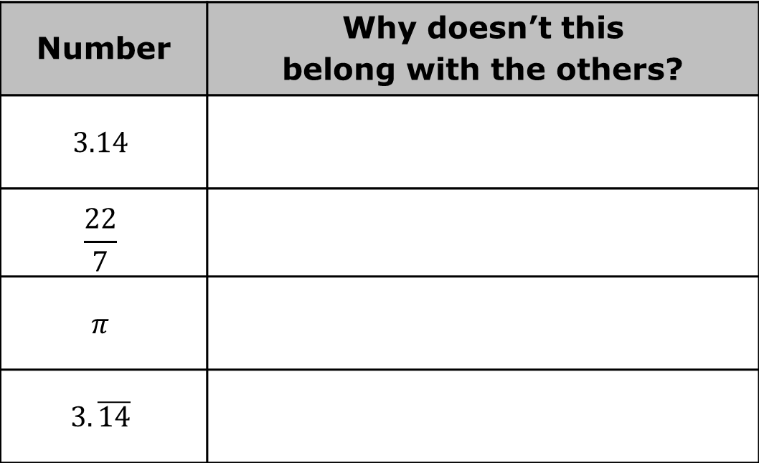
2.5.1 Warm-Up: Which One Doesn’t Belong?
Four numbers are shown in the table. Choose two of the values to write an argument for why each does not belong with the others.
Number | Why doesn’t this belong with the others?
$$3.14$$
$$\frac{22}{7}$$
$$π$$
$$3.\overline{14}$$
volume 1, pg. 87

Slide 7

Guided Instruction
volume 1, pg. 88

Slide 8
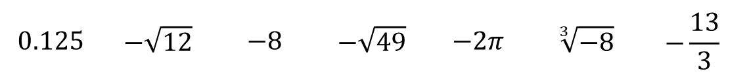
2.5.2 Guided Instruction: Compare and Order Rational and Irrational Numbers
Use the numbers shown to complete the following.
Write each number under the appropriate description in the table.
$$0.125$$ | $$−\sqrt{12}$$ | $$−8$$ | $$−\sqrt{49}$$ | $$−2π$$ | $$\sqrt[3]{−8}$$ | $$−\frac{13}{3}$$
Rational Numbers | Irrational Numbers
volume 1, pg. 88

Slide 9
Order the numbers from least to greatest.
Plot and label each number on the number line.
volume 1, pg. 88

Slide 10
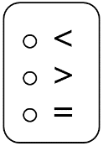

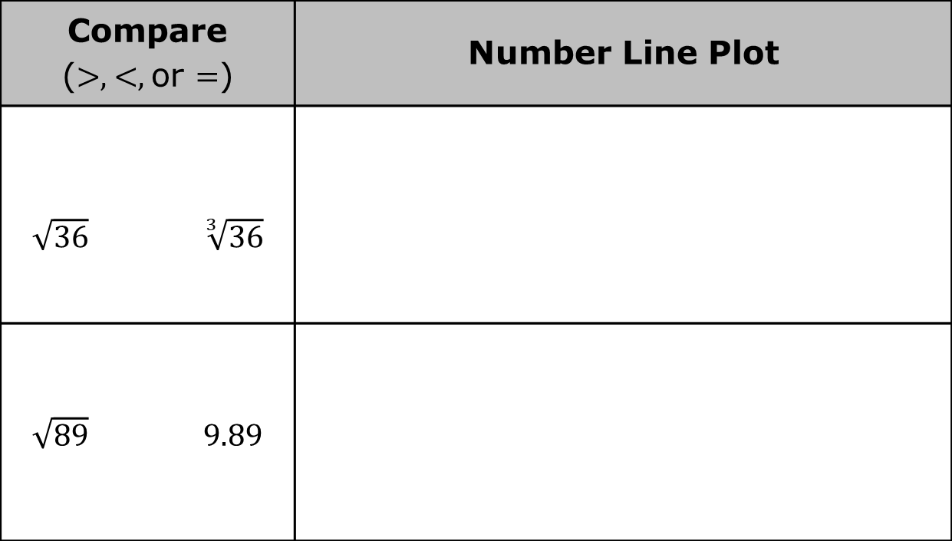
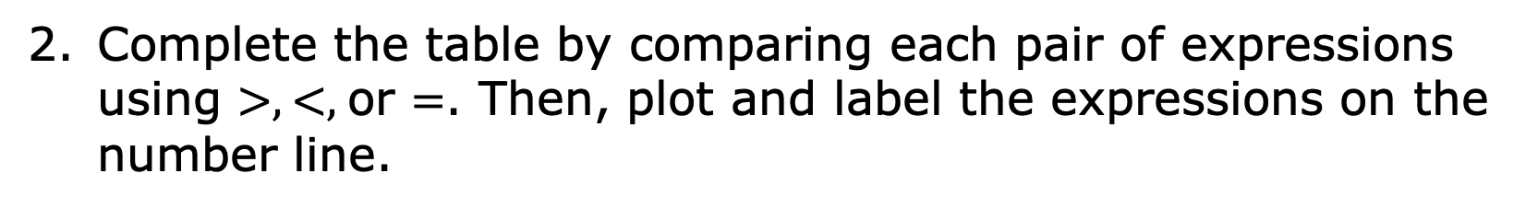
Complete the table by comparing each pair of expressions using $>$, $<$, or $=$. Then, plot and label the expressions on the number line.
Compare ($>$, $<$, or $=$) | Number Line Plot
$\sqrt{36}$ $\sqrt[3]{36}$
$\sqrt{89}$ $9.89$
volume 1, pg. 88

Slide 11
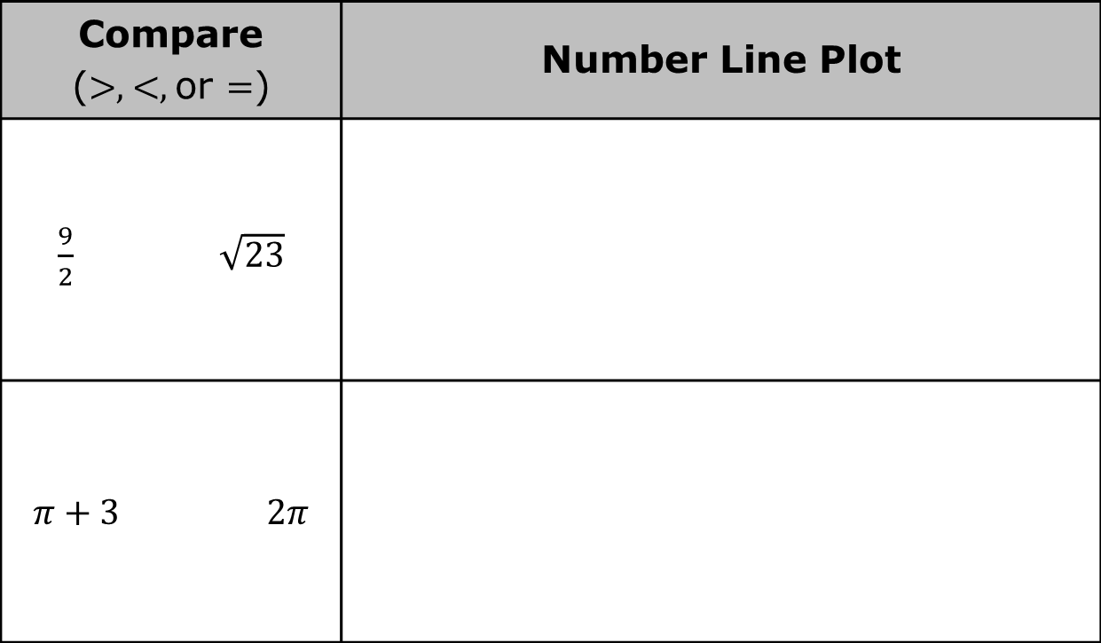
Compare ($>$, $<$, or $=$) | Number Line Plot
$\frac{9}{2}$ $\sqrt{23}$
$π+3$ $2π$
volume 1, pg. 88

Slide 12

Guided Practice
volume 1, pg. 89

Slide 13

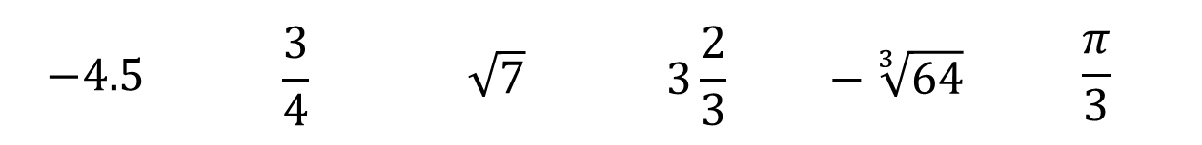
2.5.3 Guided Practice: Compare and Order Rational and Irrational Numbers
Use the numbers shown to complete the following.
Order the numbers from greatest to least.
Plot and label each number on the number line.
$$−4.5$$ | $$\frac{3}{4}$$ | $$\sqrt{7}$$ | $$3\frac{2}{3}$$ | $$− \sqrt[3]{64}$$ | $$\frac{π}{3}$$
volume 1, pg. 89

Slide 14

Activity
volume 1, pg. 89

Slide 15

2.5.4 Activity: Ordering Rational and Irrational Numbers
Your teacher will give you a card with a numerical expression on it.
What is the numerical expression on your card?
Does the expression include any irrational numbers?
If your expression contains only rational numbers, write the exact value of your card, expressed as a decimal. If your expression contains any irrational numbers, write the approximate value of your card, expressed as a decimal.
volume 1, pg. 89

Slide 16
Once in your group, label the tick marks on the number line to match your group’s assigned number line.
Work with your group to order your number cards from least to greatest.
Work with your group to determine the approximate location of each expression on the number line. Then, plot and label each expression on your number line.
volume 1, pg. 89

Slide 17

Bring It Together
volume 1, pg. 90

Slide 18

2.5.5 Bring It Together: Ordering Rational and Irrational Numbers
Use your experience doing the previous activity to complete the following.
List any strategies you learned that are helpful to keep in mind when comparing and ordering rational and irrational numbers or plotting them on a number line.
Strategies for Comparing and Ordering | Strategies for Plotting on a Number Line
volume 1, pg. 90

Slide 19
Compare and discuss your list with your partner. Add any strategies your partner shares that you find helpful that aren’t on your list.
volume 1, pg. 90

Slide 20

Wrap-Up
volume 1, pg. 90

Slide 21
2.5.6 Wrap-Up: Reflection
Write a summary of what you learned in this lesson.
volume 1, pg. 90

